Slide 1
PREDICTING HOTEL CANCELLATIONS
Letty Uy, Luke Kuller, Rocio Noriega, Erica Kane & Trang Dinh

Slide 2


INTRODUCTION
For our final project, we decided to focus on and examine the “Hotel Booking Demand” dataset via Kaggle.com. Through this dataset we sought to explore this real-world problem, specifically related to hotel cancellations, which provoked our collective intrigue into providing a viable answer to the hospitality and tourism industry.

Slide 3

DESCRIPTION OF THE DATA-SET & OUR OBJECTIVE
The “Hotel Booking Demand” dataset features 32 total columns.
Our chosen dependent variable was the column, Is_Cancelled and we decided to utilize only columns, Distribution_Channel, Previous_Cancellations, Deposit_Type, Lead_Time, and Average_Daily_Rate or “ADR,” for our independent variables.
Our objective was to provide meaningful understanding and resolution to the issue of hotel cancellations.
Through our findings, we will uncover trends and patterns that will enable us to provide relevant and impactful answers that allow the hospitality and tourism industry to better understand the various questions and aspects related to cancellations.

Slide 4

THE QUESTIONS
The reason why we chose the five independent variables we did, in relation to our decision variable of Is_Cancelled, is because we believed they would produce the strongest results for us to answer our objective of predicting hotel cancellations. Regarding our independent variables, the questions in which our data will provide answers to are:
Which travelers are more likely to cancel?
Customers track records and if they’re prone to canceling in the past.
If the customer puts down a deposit, are they more likely to not cancel?
Looking at the high or low lead times and whether we can see what the relationship is with cancellations.
What ADR is more likely to result in cancellations?

Slide 5
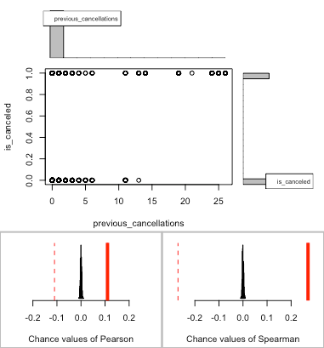
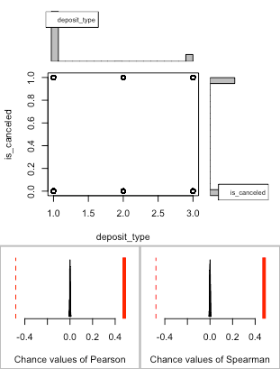
ASSOCIATION ANALYSIS
Association between previous_cancellations (numerical) and is_canceled (converted boolean) using 119390 complete cases
Permutation procedure:
Value Estimated p-value
Pearson's r 0.1101328 0
Spearman's rank correlation 0.2702334 0
With 500 permutations, we are 95% confident that:
the p-value of Pearson's correlation (r) is between 0 and 0.007
the p-value of Spearman's rank correlation is between 0 and 0.007
Note: If 0.05 is in this range, increase the permutations= argument.
Association between deposit_type (numerical) and is_canceled (converted boolean) using 119390 complete cases
Permutation procedure:
Value Estimated p-value
Pearson's r 0.4686338 0
Spearman's rank correlation 0.4770607 0
With 500 permutations, we are 95% confident that:
the p-value of Pearson's correlation (r) is between 0 and 0.007
the p-value of Spearman's rank correlation is between 0 and 0.007
Note: If 0.05 is in this range, increase the permutations= argument.

Slide 6
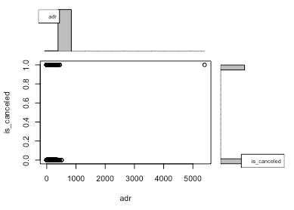
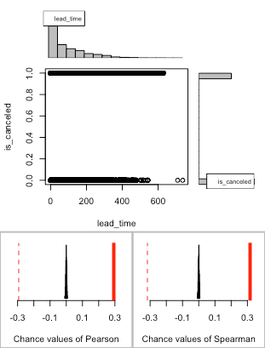
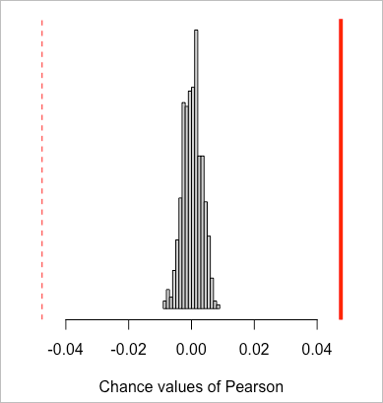
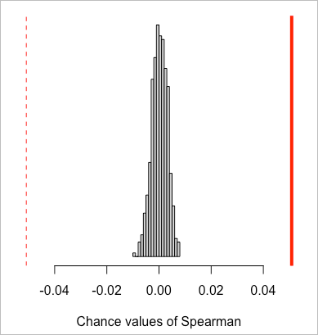
ASSOCIATION ANALYSIS
Association between adr (numerical) and is_canceled (converted boolean) using 119390 complete cases
Permutation procedure:
Value Estimated p-value
Pearson's r 0.04755660 0
Spearman's rank correlation 0.05087593 0
With 500 permutations, we are 95% confident that:
the p-value of Pearson's correlation (r) is between 0 and 0.007
the p-value of Spearman's rank correlation is between 0 and 0.007
Note: If 0.05 is in this range, increase the permutations= argument.
Association between lead_time (numerical) and is_canceled (converted boolean) using 119390 complete cases
Permutation procedure:
Value Estimated p-value
Pearson's r 0.2931234 0
Spearman's rank correlation 0.3166346 0
With 500 permutations, we are 95% confident that:
the p-value of Pearson's correlation (r) is between 0 and 0.007
the p-value of Spearman's rank correlation is between 0 and 0.007
Note: If 0.05 is in this range, increase the permutations= argument.

Slide 7
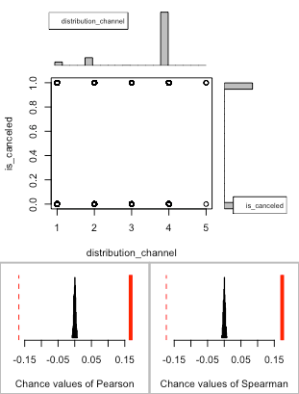

ASSOCIATION ANALYSIS
Association between distribution_channel (numerical) and is_canceled (converted boolean)
using 119390 complete cases
Permutation procedure:
Value Estimated p-value
Pearson's r 0.1676003 0
Spearman's rank correlation 0.1736620 0
With 500 permutations, we are 95% confident that:
the p-value of Pearson's correlation (r) is between 0 and 0.007
the p-value of Spearman's rank correlation is between 0 and 0.007
Note: If 0.05 is in this range, increase the permutations= argument.

Slide 8
ASSOCIATION ANALYSIS:
LOG OUTPUTS
Previous_Cancellations
Deposit_Type
Call:
glm(formula = is_canceled ~ previous_cancellations, family = binomial,
data = smallhotel)
Coefficients:
Estimate Std. Error z value Pr(>|z|)
(Intercept) -0.642251 0.006261 -102.58 <2e-16 ***
previous_cancellations 2.060846 0.032777 62.88 < 2e-16 ***
---
Signif. codes: 0 ‘***’ 0.001 ‘**’ 0.01 ‘*’ 0.05 ‘.’ 0.1 ‘ ’ 1
(Dispersion parameter for binomial family taken to be 1)
Null deviance: 157398 on 119389 degrees of freedom
Residual deviance: 151456 on 119388 degrees of freedom
AIC: 151460
Number of Fisher Scoring iterations: 6
Call:
glm(formula = is_canceled ~ deposit_type, family = binomial,
data = smallhotel)
Coefficients:
Estimate Std. Error z value Pr(>|z|)
(Intercept) -0.925836 0.006857 -135.019 <2e-16 ***
deposit_type3 5.974727 0.104232 57.321 <2e-16 ***
deposit_type2 -0.326927 0.189107 -1.729 0.0838 .
---
Signif. codes: 0 ‘***’ 0.001 ‘**’ 0.01 ‘*’ 0.05 ‘.’ 0.1 ‘ ’ 1
(Dispersion parameter for binomial family taken to be 1)
Null deviance: 157398 on 119389 degrees of freedom
Residual deviance: 126130 on 119387 degrees of freedom
AIC: 126136
Number of Fisher Scoring iterations: 7

Slide 9
ASSOCIATION ANALYSIS:
LOG OUTPUTS
Average_Daily_Rate
Lead_Time
Call:
glm(formula = is_canceled ~ adr, family = binomial,
data = smallhotel)
Coefficients:
Estimate Std. Error z value Pr(>|z|)
(Intercept) -0.7429287 0.0140628 -52.83 <2e-16 ***
adr 0.0020755 0.0001236 16.80 <2e-16 ***
---
Signif. codes: 0 ‘***’ 0.001 ‘**’ 0.01 ‘*’ 0.05 ‘.’ 0.1 ‘ ’ 1
(Dispersion parameter for binomial family taken to be 1)
Null deviance: 157398 on 119389 degrees of freedom
Residual deviance: 157115 on 119388 degrees of freedom
AIC: 157119
Number of Fisher Scoring iterations: 4
Call:
glm(formula = is_canceled ~ lead_time, family = binomial,
data = smallhotel)
Coefficients:
Estimate Std. Error z value Pr(>|z|)
(Intercept) -1.166e+00 9.182e-03 -126.9 <2e-16 ***
lead_time 5.855e-03 6.137e-05 95.4 <2e-16 ***
---
Signif. codes: 0 ‘***’ 0.001 ‘**’ 0.01 ‘*’ 0.05 ‘.’ 0.1 ‘ ’ 1
(Dispersion parameter for binomial family taken to be 1)
Null deviance: 157398 on 119389 degrees of freedom
Residual deviance: 147158 on 119388 degrees of freedom
AIC: 147162
Number of Fisher Scoring iterations: 4

Slide 10


ASSOCIATION ANALYSIS:
LOG OUTPUTS
Distribution_Channel
Call:
glm(formula = is_canceled ~ distribution_channel, family = binomial,
data = smallhotel)
Coefficients:
Estimate Std. Error z value Pr(>|z|)
(Intercept) -1.26126 0.02951 -42.745 < 2e-16 ***
distribution_channel2 -0.29212 0.03667 -7.967 1.63e-15 ***
distribution_channel3 -0.17768 0.18522 -0.959 0.3374
distribution_channel4 0.89836 0.03021 29.734 < 2e-16 ***
distribution_channel5 2.64755 1.11842 2.367 0.0179 *
---
Signif. codes: 0 ‘***’ 0.001 ‘**’ 0.01 ‘*’ 0.05 ‘.’ 0.1 ‘ ’ 1
(Dispersion parameter for binomial family taken to be 1)
Null deviance: 157398 on 119389 degrees of freedom
Residual deviance: 153314 on 119385 degrees of freedom
AIC: 153324
Number of Fisher Scoring iterations: 4

Slide 11
REGRESSION ANALYSIS: MULTIPLE LOGIT REGRESSION MODEL
Call:
glm(formula = is_canceled ~ lead_time + distribution_channel +
previous_cancellations + deposit_type + adr, family = binomial,
data = smallhotel)
Coefficients:
Estimate Std. Error z value Pr(>|z|)
(Intercept) -2.502e+00 3.994e-02 -62.641 <2e-16 ***
lead_time 2.828e-03 7.424e-05 38.085 < 2e-16 ***
distribution_channel2 -8.596e-02 4.529e-02 -1.898 0.05770 .
distribution_channel3 3.088e-01 1.879e-01 1.644 0.10017
distribution_channel4 7.988e-01 3.924e-02 20.353 < 2e-16 ***
distribution_channel5 3.597e+00 1.127e+00 3.192 0.00141 **
previous_cancellations 1.331e+00 3.779e-02 35.216 < 2e-16 ***
deposit_type3 5.618e+00 1.046e-01 53.720 < 2e-16 ***
deposit_type2 8.498e-02 1.946e-01 0.437 0.66231
adr 5.596e-03 1.436e-04 38.965 < 2e-16 ***
---
Signif. codes: 0 ‘***’ 0.001 ‘**’ 0.01 ‘*’ 0.05 ‘.’ 0.1 ‘ ’ 1
(Dispersion parameter for binomial family taken to be 1)
Null deviance: 157398 on 119389 degrees of freedom
Residual deviance: 119114 on 119380 degrees of freedom
AIC: 119134
Number of Fisher Scoring iterations: 7
No deposit & a refundable deposit had no statistically significant prediction ability.
Having a non-refundable deposit increased the likelihood of cancelling.
A longer lead time increased the likelihood of cancelling.
As previous cancellations increased, so did the likelihood of cancelling.
As adr increased, so did the likelihood of cancelling.
Distribution channels “TA/TO” and undefined increased the likelihood of cancelling.

Slide 12

REGRESSION ANALYSIS:
MULTIPLE LOGIT REGRESSION MODEL
This study aimed to investigate the factors that influence
hotel booking cancellations, and multiple logistic regression was used as a model to identify the predictors of cancellation.
The model showed that all the predictor variables were statistically significant in association with the probability of hotel booking cancellations.

Slide 13
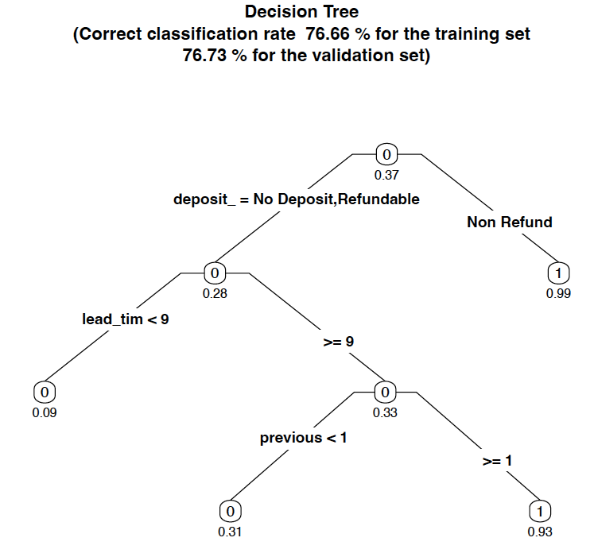

ADDITIONAL TECHNIQUES:
DECISION TREE
The results are consistent with the multiple logit regression, showcasing the most significant and impactful variables towards predicting cancellations.

Slide 14
OUR FINDINGS
The travelers that are most likely to cancel are those that went through travel agents as opposed to booking directly.
The higher the number of previous cancellations a person has, the higher the likelihood of cancelling.
If the customer puts down a non-refundable deposit, they are more likely to cancel.
The greater the lead time between booking and date of stay, the higher the likelihood of cancelling.
As ADR (room rate) increased, so did the likelihood of cancelling.

Slide 15

RECOMMENDATIONS
To decrease cancellations while balancing the need to maximize profit we recommend:
Removing non-refundable deposits from rooms that have a low likelihood of canceling
rooms booked directly by the guest
rooms booked with a short lead time
rooms booked with a low ADR
Limiting how far in advance rooms can be booked and adding a non-refundable deposit on rooms booked well in advance of the stay.
Adding non-refundable deposits on rooms booked by travel agents and by guests who have previously cancelled stays.
Utilizing dynamic pricing based on supply & demand to reduce cancellations due to finding a lower ADR room without lowering pricing across the board.

Slide 16


